Slide 1


UNIVERSITY OF AGRICULTURE, FAISALBAD
TITLE: INTRODUCTION TO BIOINFORMATICS
PRESENTED BY:
Fatima Naveed (2023-ag-9736) Qurat-ul-Ain (2023-ag-9777) Aliza Fatima (2023-ag-9712) Malaika Shahzadi (2023-ag-9756) Ayesha Jahangir (2023-ag-9721) Esha Khan (2023-ag-9732) Ayesha Mustafa (2023-ag-9722)
PRESENTED TO:
MAM MISBAH

Slide 2
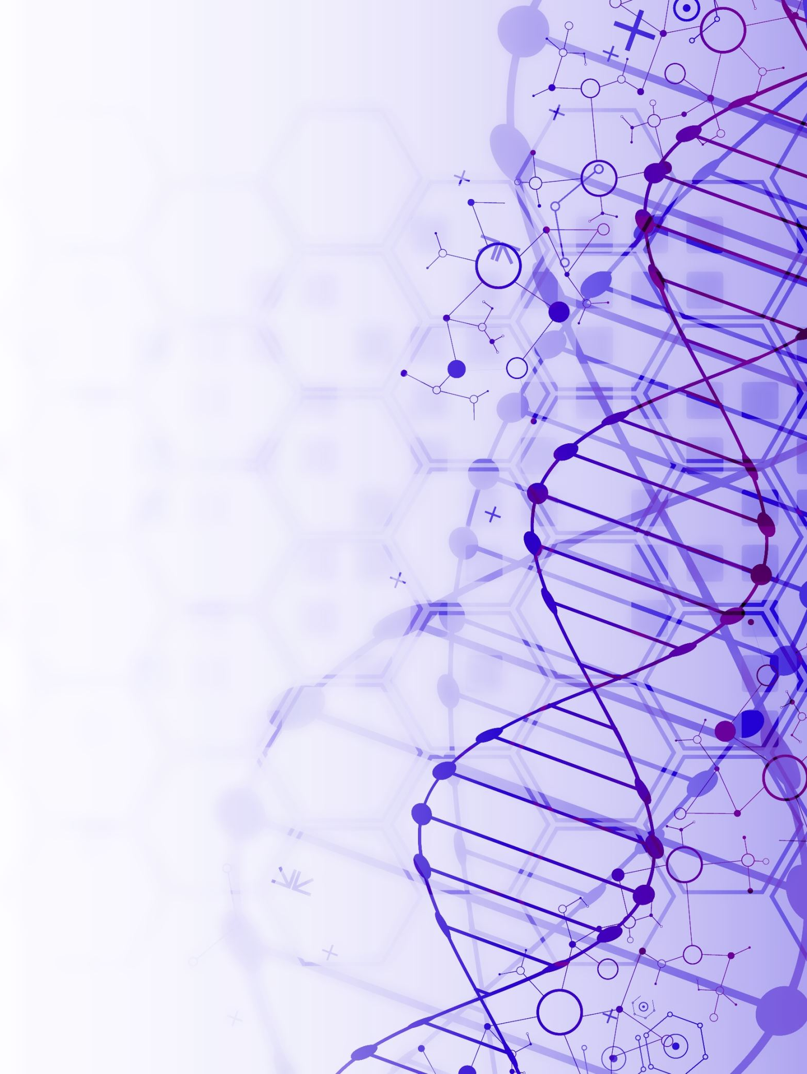
CONTENTS
SECTION 1: FROM BIOLOGICAL DATA TO INTELLIGENT DISCOVERY
SECTION 2: BIOLOGICAL INFORMATION SYSTEM
SECTION 3: BIOLOGICAL DATA MANAGEMENT
SECTION 4: SEQUENCE ANALYSIS & EVOLUTION
SECTION 5: GENOMICS, EXPRESSION & PROTEOMICS
SECTION 6: MODERN APPLICATIONS
SECTION 7: INTERNET & FUTURE TECHNOLOGIES

Slide 3
SECTION 1: FROM BIOLOGICAL DATA TO INTELLIGENT DISCOVERY
Why Bioinformatics Became Necessary?
Modern biology generates enormous amounts of data.
Manual analysis is no longer sufficient.
Computational tools became essential for biological research.
Bioinformatics bridges biology with computing and data science.

Slide 4
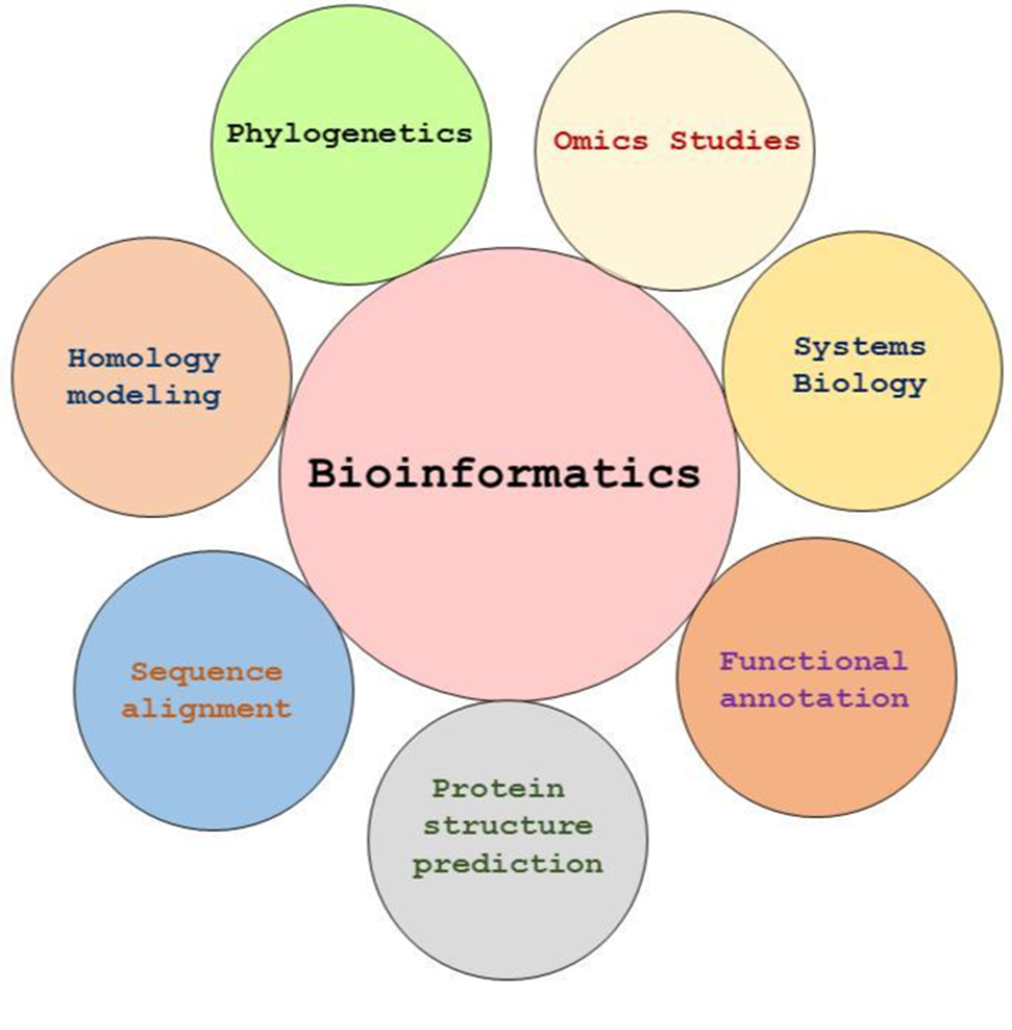
What Is Bioinformatics?
Bioinformatics is an interdisciplinary field that applies computational methods, statistics, and information technology to store, analyze, interpret, and visualize biological data.
Main Objectives
Biological data storage
Sequence analysis
Structure prediction
Functional analysis
Biological visualization

Slide 5
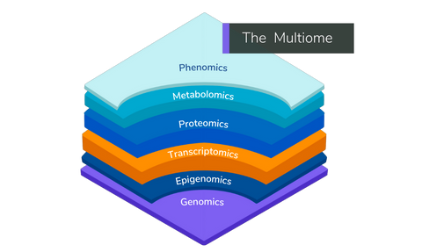
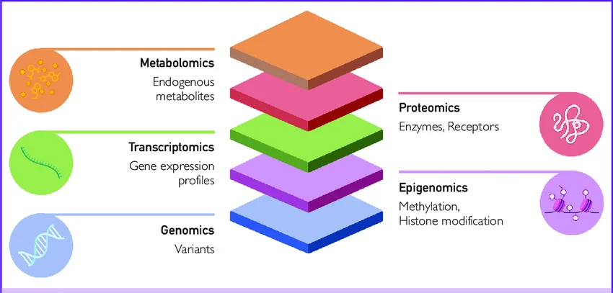
SECTION 2: BIOLOGICAL INFORMATION SYSTEM
Information Molecule & Information Flow
Biological Information
Flow(CENTRAL DOGMA)
DNA → RNA → Protein
Key Concepts
DNA stores genetic information.
RNA transfers information.
Proteins perform cellular functions.
Cellular activity occurs at multiple biological levels.
BIOLOGICAL ACTIVITY LEVELS

Slide 6
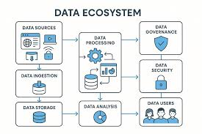
SECTION 3: BIOLOGICAL DATA MANAGEMENT
Biological Database & Data Retrieval System
Why Databases Are Important
Biological databases organize, store, and retrieve massive amounts of genomic and proteomic information.
Major Databases
Relational Databases
Object-Oriented Databases
Nucleotide Databases
Structural Databases
Protein Databases
Literature Databases

Slide 7
Major Databases In Bioinformatics:
Database | Electronic address (URL) | Database | Electronic address (URL)
Protein sequence (primary) |  | Integrated databases
SWISS-PROT | http://www.expasy.org/sprot/ | InterPro | http://www.ebi.ac.uk/interpro/
PIR-International | pir.georgetown.edu/ | Sequence retrieval system (SRS) | http://www.expasy.ch/srs5
Protein sequence (composite) |  | Entrez | http://www.ncbi.nlm.nih.gov/Entrez
OWL | http://unber.sbs.man.ac.uk/dbbrowser/OWL/ | Genome sequences
Protein sequence (secondary) |  | Entrez genomes | http://www.ncbi.nlm.nih.gov/entrez/query.fcgi?db=Genome
PROSITE | http://www.expasy.org/prosite/ | GeneCensus | http://bioinfo.mbb.yale.edu/genome/
PRINTS | http://unber.sbs.man.ac.uk/dbbrowser/PRINTS/ | COGs | http://www.ncbi.nlm.nih.gov/COG/
Pfam | http://www.sanger.ac.uk/Software/Pfam/ | Nucleotide sequences
Macromolecular structures |  | GenBank | http://www.ncbi.nlm.nih.gov/Genbank/
Protein Data Bank (PDB) | www.rscb.org/pdb/ | EMBL | http://www.ebi.ac.uk/embl/
Nucleic Acids Database (NDB) | http://ndbserver.rutgers.edu/ | DDBJ | http://www.ddbj.nig.ac.jp/
HIV Protease Database | http://mcl1.nciirf.gov/hivdb/

Slide 8
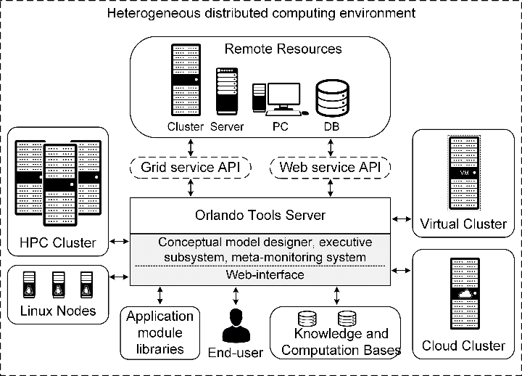
Linux & Computational Environment
Linux-based bioinformatics workflows
High-throughput data processing
Integrated biological servers

Slide 9
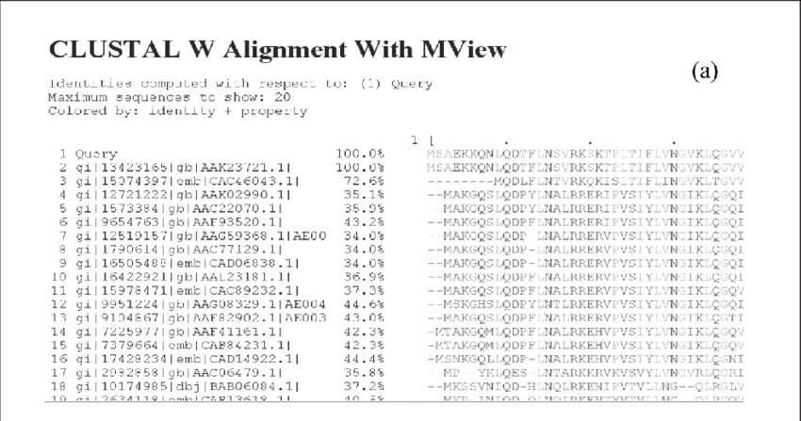
SECTION 4: SEQUENCE ANALYSIS & EVOLUTION
Sequence Alignment & Similarity Search
Sequence Analysis identifies similarities between DNA, RNA, or protein sequences.
Types of Alignment
Pairwise alignment
Multiple sequence alignment
Similarity Search Tools
BLAST
FASTA
PSI-BLAST
ClustalW
Importance
Detect homologous genes
Study mutations
Functional prediction

Slide 10
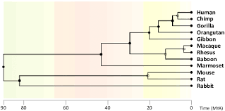
Phylogenetic Analysis
Phylogenetic analysis studies evolutionary relationships among organisms using sequence data.
Key Applications
Comparative genomics
Species classification
Evolutionary studies
Tools
ClustalW
NCBI Taxonomy

Slide 11
SECTION 5: GENOMICS, EXPRESSION & PROTEOMICS
Genome Analysis & Gene Mapping
Genome Analysis identifies functional regions within DNA sequences.
Includes
Hidden Markov Model
Gene mapping
Sequence assembly
Genome annotation
ORF identification
Splice site prediction
Gene Prediction Tools
GeneMark
GRAIL
ORF Finder

Slide 12
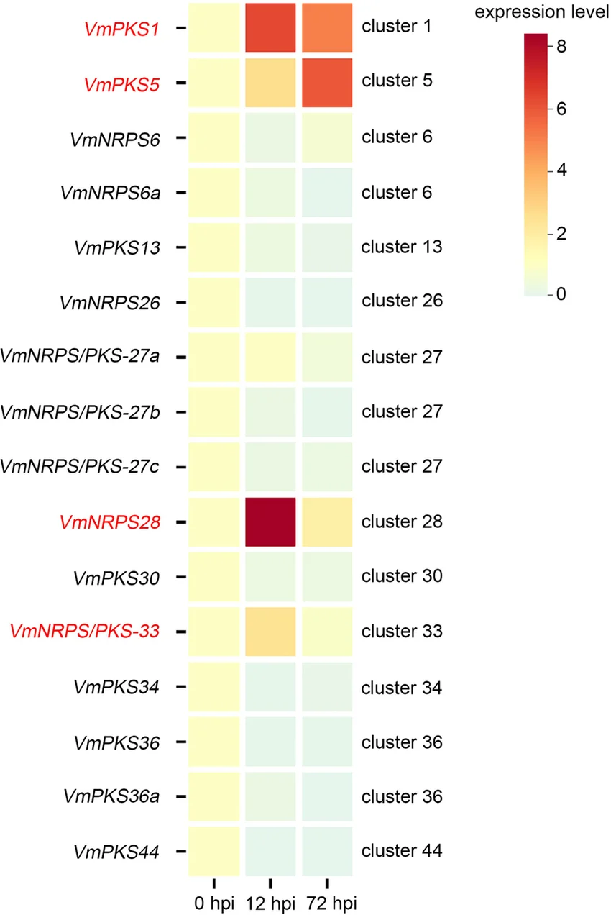
Gene Expression & Microarrays
Gene Expression analysis measures how actively genes are expressed in cells.
Microarray Technology
Used to analyze thousands of genes simultaneously.
Applications
Cancer research
Disease biomarkers
Drug response analysis
Tools
ArrayExpress
ClustArray

Slide 13
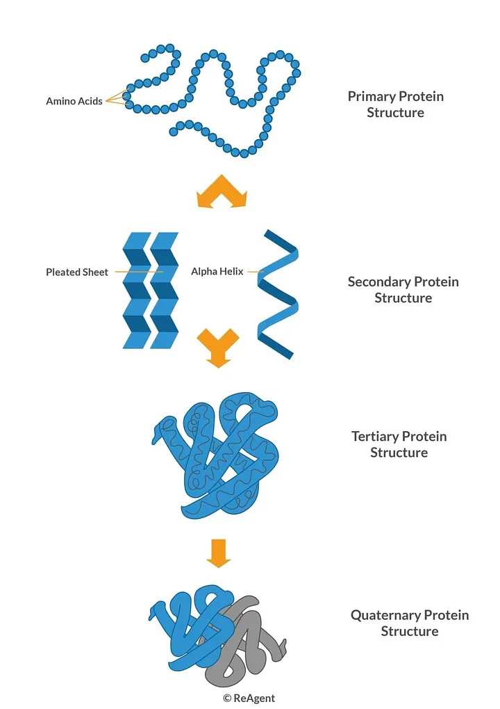
Protein Structure Prediction & Visualization
Protein Structure Prediction & Analysis:
Computational tools predict 3D protein structures.
Protein structure determines biological function.
Important Tools
Swiss-Model
TMpred
PredictProtein
RasMol
Cn3D

Slide 14
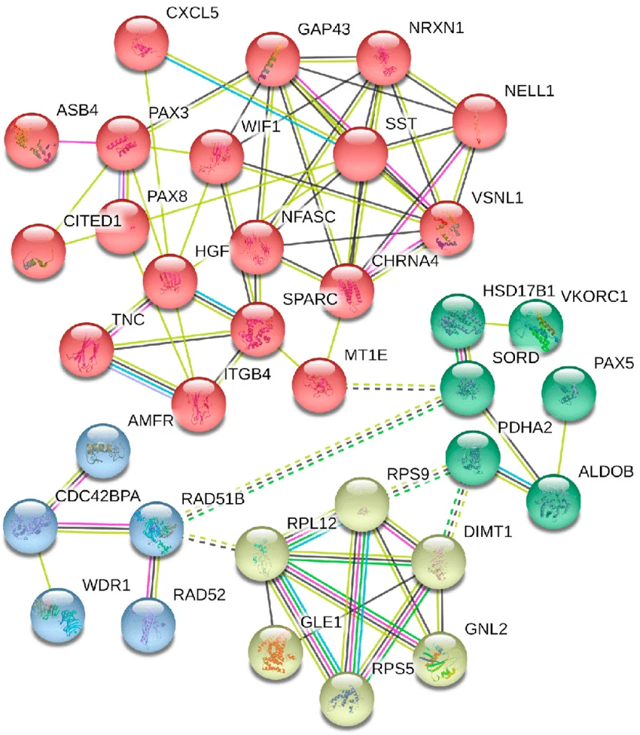
Proteomics & Systems Biology
Proteomics
Study of protein expression, structure, and interactions.
Systems Biology
Analyzes interactions between genes, proteins, and metabolic pathways.
Include
Protein-protein interactions
Pathway analysis
Metabolic networks
Important Databases
KEGG
EcoCyc
DIP

Slide 15
SECTION 6: MODERN APPLICATIONS

Slide 16
Statistical Analysis & Problem Solving
Importance of Statistical Analysis
Biological data is large, complex, and highly variable. Statistical methods help transform raw biological data into meaningful scientific information.
Major Applications
Gene expression analysis
Sequence comparison
Microarray analysis
Disease prediction
Biological pattern recognition
Problem Solving in Bioinformatics
Bioinformatics uses computational methods(Algorithms, Data mining, Machine learning, Predictive modeling) to solve complex biological problem.

Slide 17
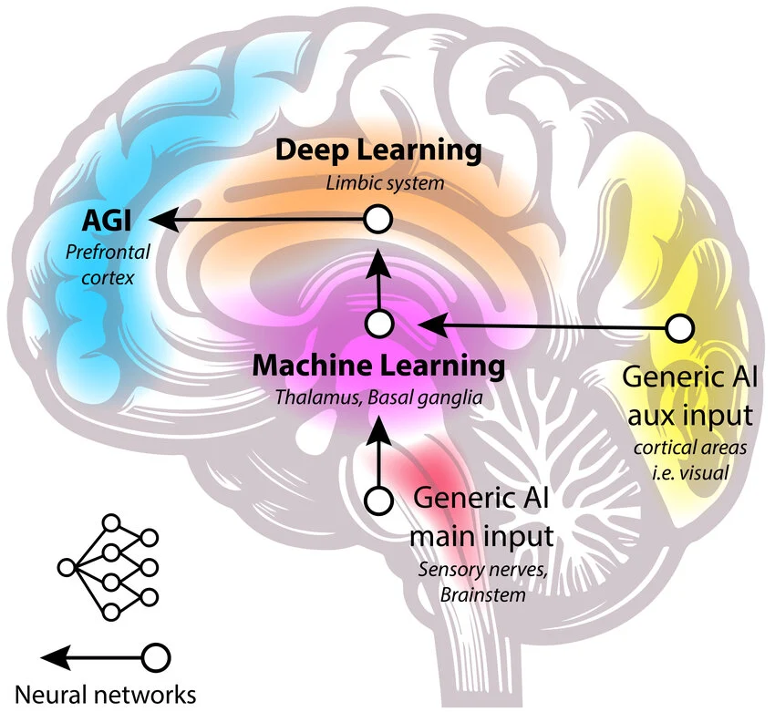
Artificial Intelligence in Bioinformatics
Disease prediction
Protein folding
Drug discovery
Genomic pattern recognition
Personalized medicine
Protein structure prediction(AlphaFold protein prediction system)
Analyzing biological data rapidly

Slide 18
SECTION 7: INTERNET & FUTURE TECHNOLOGIES
Internet Technologies in Bio-informatics
HTML(Hyper Text Markup Language)
CSS
XML
XSL/XSLT
Remote Procedure Invocation
Importance
These technologies support:
Biological web databases
Online genome browsers
Scientific visualization
Data sharing and communication
Notes:
Visualization Methods for DNA Sequences: A Review and Prospects
by
Tan Li
¹,
Mengshan Li
^{1,*},
Yan Wu
² and
Yelin Li
¹
¹
School of Physics and Electronic Information, Gannan Normal University, Ganzhou 341000, China
²
School of Mathematics and Computer Science, Gannan Normal University, Ganzhou 341000, China
*
Author to whom correspondence should be addressed.
Biomolecules 2024, 14(11), 1447; https://doi.org/10.3390/biom14111447
Submission received: 17 October 2024 / Revised: 8 November 2024 / Accepted: 12 November 2024 / Published: 14 November 2024
(This article belongs to the Section Bioinformatics and Systems Biology)

Slide 19
Challenges:
Massive biological datasets
Data integration problems
Computational limitations
Statistical complexity
Data privacy and security
Interpretation of multi-omics data
Need:
Advanced computational algorithms and high-performance computing.

Slide 20
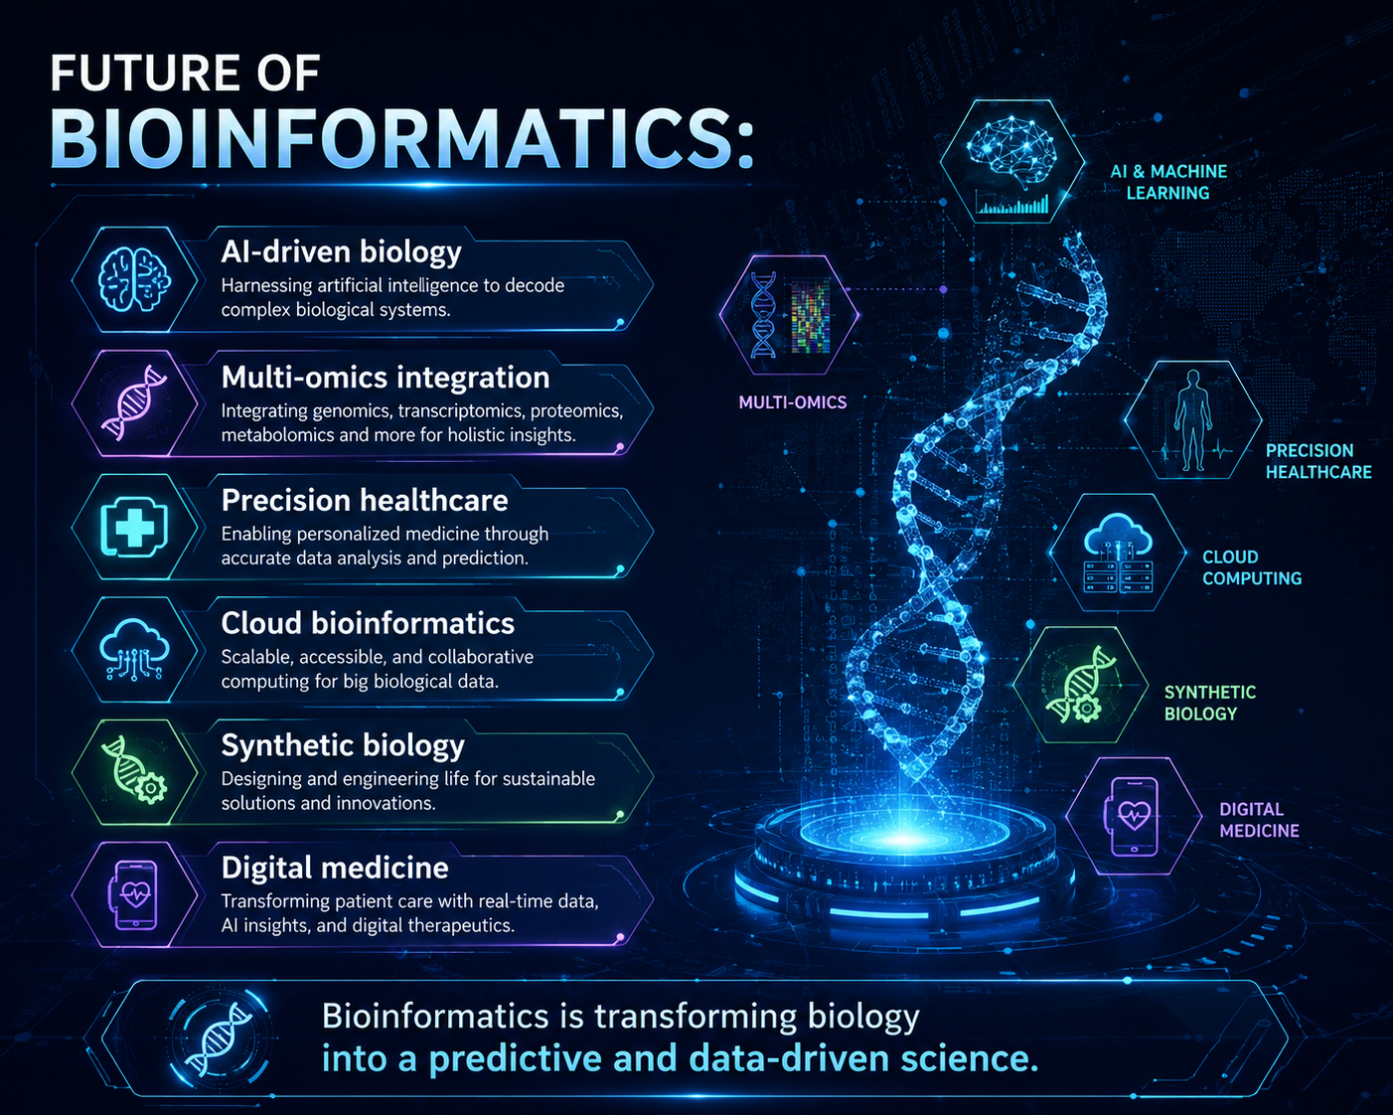

Slide 21
References:
Books:
Bioinformatics: Concepts, Skills & Applications
Bioinformatics: Methods and Applications
Bioinformatics: Genes, Proteins & Computers

